Slide 1
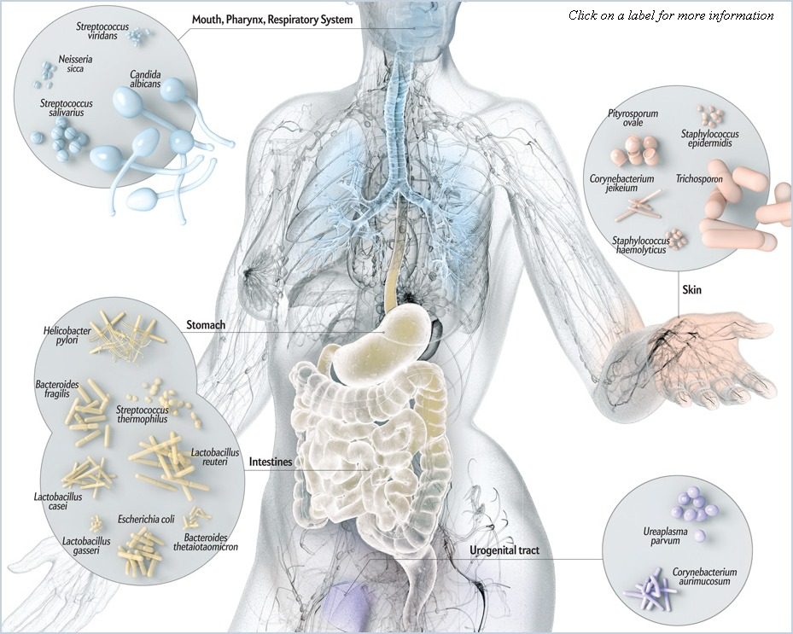
Analyzing the Microbiome
Notes:
Lead a discussion about the microbiome/microbiota and why it’s so important to study
How might the microbiom affect health?
Where do the microbes come from?
What could affect the microbiome of an organism?

Slide 2
Microbiome/Microbiota
Microbiome - a microbial community occupying a well-defined habitat as well as its “theatre of activity.”
“theatre of activity” includes microbial genetic elements, structural elements, metabolites, and surrounding micro-environmental conditions
Microbiota – all living members forming the microbiome
“a dynamic and interactive micro-ecosystem”
Berg et al. Microbiome 2020
Notes:
Lead a discussion about the microbiome/microbiota and why it’s so important to study
How might the microbiom affect health?
Where do the microbes come from?
What could affect the microbiome of an organism?

Slide 3
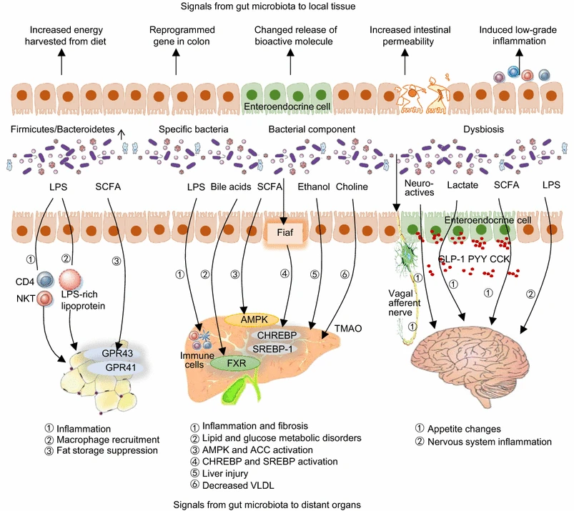
Sun et al. Protein Cell 2018

Slide 4
Microbiome implicated in:
Health of resident tissue (gut, skin, mouth, etc.)
GI infection, inflammatory bowel disease, atopic dermatitis, periodontal disease
Health of non-resident tissues
Endocrine activity, liver disease, kidney disease, hair loss
Metabolism
Obesity, metabolic syndrome, diabetes
Immune system development
Asthma, allergy, autoimmunity
Immune responses
Inflammation, antibody production, response to infection, hypertension
Brain function
Mood, anxiety, depression, pain, neurodevelopmental disorders, neurodegenerative disease
Drug metabolism
Bioavailability, efficacy, tolerance

Slide 5

The promise of the microbiome
Personalized medicine
Symptom management
Preventing chronic conditions
Probiotics
Biomarkers
Prebiotics

Slide 6

Describing the microbiome
What taxa are there? How many microbes from each taxon are there? Do microbial populations differ based on variables of interest?

Slide 7
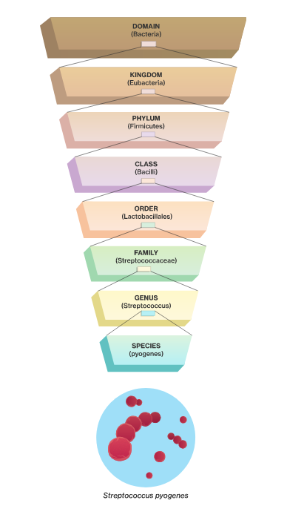
Describing the microbiome
What taxa are there? How many microbes from each taxon are there? Do microbial populations differ based on variables of interest?

Slide 8
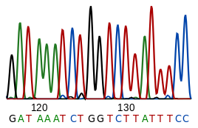
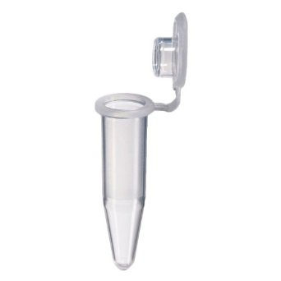

Sequencing
Biological Sample
Amplify DNA using PCR
Sequence the DNA
Amplicon sequencing (16S) – just bacteria, just one region of genomes, taxonomic resolution can be limited, little sample required, inexpensive, established analytics
Whole genome (shotgun) sequencing – sequence all DNA in sample, captures fungi and viruses as well as bacteria, precise taxonomic resolution, large sample required, expensive, challenging bioinformatics
Notes:
Give overview of what we’re doing. Be sure to explain that the colony they pick will have lots of bacterial cells each with DNA. PCR machine will first go to high temp to burst open cells and free all that DNA inside the bacteria.

Slide 9
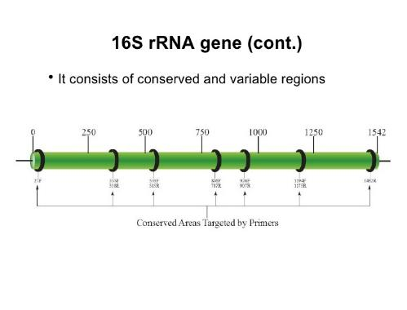

16S Sequencing
Region of the genome present in all bacteria
Conserved areas where DNA is the same in all bacteria (where primers bind)
Variable areas that are different in different taxa (to distinguish them)
Notes:
Give overview of what we’re doing. Be sure to explain that the colony they pick will have lots of bacterial cells each with DNA. PCR machine will first go to high temp to burst open cells and free all that DNA inside the bacteria.

Slide 10
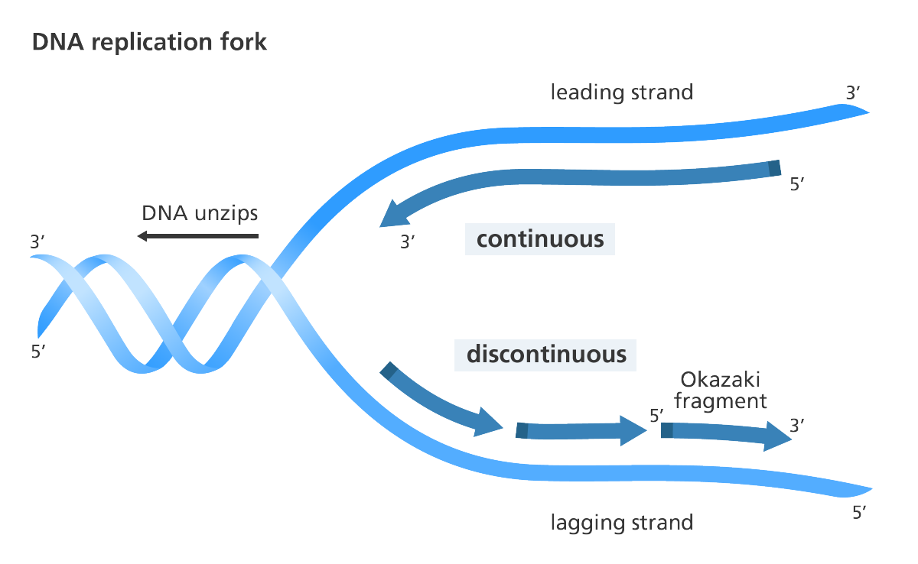
16S Sequencing
Notes:
Give overview of what we’re doing. Be sure to explain that the colony they pick will have lots of bacterial cells each with DNA. PCR machine will first go to high temp to burst open cells and free all that DNA inside the bacteria.

Slide 11
Sequence Data Processing: Filtering and Trimming
Notes:
The beginning and ends of sequencing reactions are often ‘messy’ and should not be considered reliable sequence. We trim these ends (delete them from our reliable sequence text) before further analyses (such as BLAST search).
What do we consider ‘messy’ and not reliable?
Multiple peaks for same base position
Peaks not much higher than background levels
No breaks between peaks – ie can’t tell when one peak ends and next begins
Why are the ends often messy?
Because it is difficult to resolve (clearly separate) very short or long fragments in the gel. Short fragments travel so quickly it is difficult to resolve while long fragments are different by such a small percentage of their total length that they are difficult to resolve.
Also once long enough don’t have many of the sequencing reactions producing product that long

